Slide 1
From your ACA account, select the BUILDING tab. Select CREATE AN APPLICATION.
After reading the General Disclaimer, check the box and select CONTINUE APPLICATION.

Slide 2
Under COMMERCIAL PERMITS, pull down and select Commercial New Construction Permit. Select CONTINUE APPLICATION.
Using the SAVE FROM ACCOUNT, ADD NEW or LOOK UP, add both an applicant and a bond provider.

Slide 3
Selecting a Contact from Account will allow you to quickly find any previously entered data from your registration or previous applications.
Selecting Look Up Contact will allow you to search by name, location or contact information from your registration or previous applications.

Slide 4
Select LOOK UP to search for registered contractors. You may have multiple contractors each doing a single trade or a single contractor performing many trades. Each trade will have its own line item.
TYPE will allow you to select a General Contractor, General Contractor with Trades or Subcontractor. Third Party Review is for DuPage County use only. You can also search by name, address, phone or trade. Trade will pull up all registered contractors for that particular trade. If you cannot find your contractor, he may need to register or renew his registration. Contact your contractor.

Slide 5
Pull down ACTIONS to edit your contractor’s trade. You can only choose a trade your contractor is registered for under Registered Trades
Choose the trade your contractor is performing, then select SUBMIT.

Slide 6
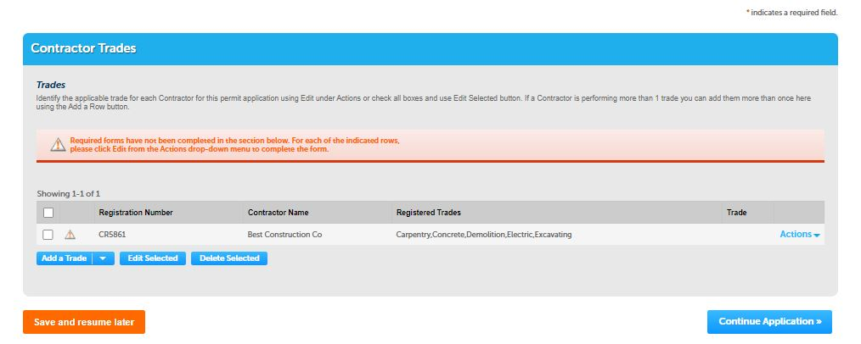
ADD A ROW will allow you to add multiple contractors at a time. You can also use this if you have a single contractor doing multiple trades.
If you are unsure of your contractor’s registration number or information, you can select the REPORTS drop down at the top of the page to see a complete list of registered contractors. Contractors can also be added to the application using AMENDMENTS at a later time. A permit will not be issued until all applicable trades are assigned a registered contractor

Slide 7
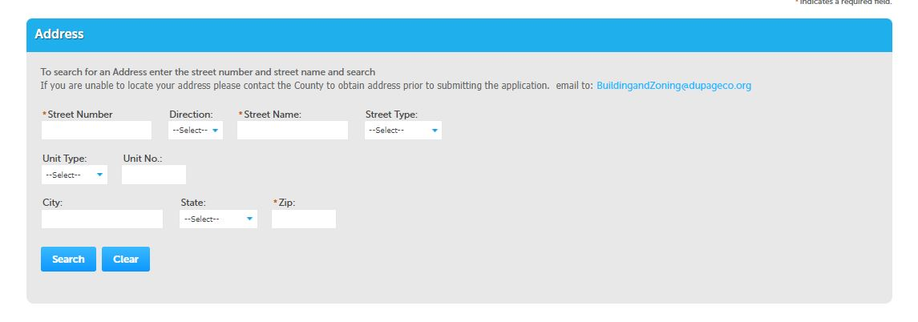
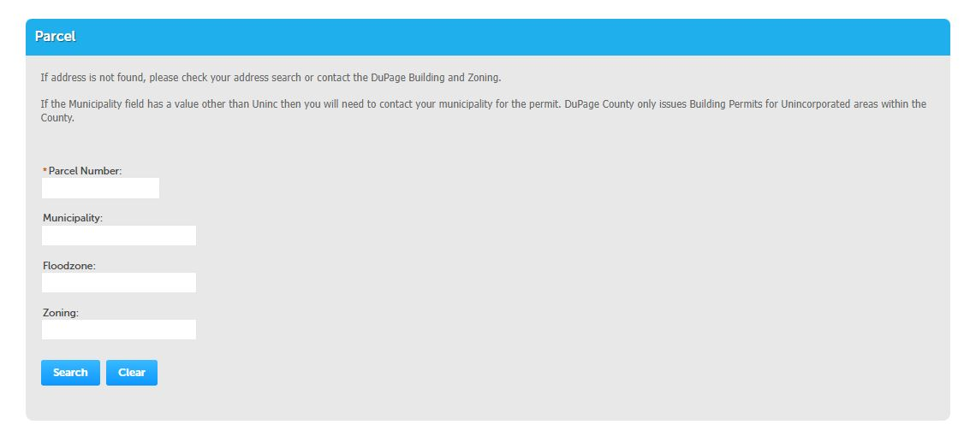
After completing contractors, select the location of construction by using either the Address or the Parcel field. SEARCH will autofill all other fields including the recorded owner. If searching by address is problematic, the 10-digit Property Identification Number (PIN) from your tax documents or deed should be used.
Select the type of ownership, Bank/Trust Company, Family Trust or Individual, from the drop down. If the property is owned by a bank or trust company, a Trust Disclosure from your bank will be required to submit your application. If you are in a Family Trust (ie: Smith Family Rev Tr), you will need to provide a trust document with the Trustee’s name. Select Individual if the property is owned by one or more individuals or a trust with a single name (ie: Bob Smith Trust). Select CONTINUE APPLICATION.

Slide 8
Describe the scope of work for which you are applying. Provide adequate detail. Descriptions which are vague or inconsistent will be rejected.
Complete the required fields as indicated by the red asterisk. If required fields are not complete, a notice will appear directing you to the unfinished items. All items must be complete to continue.

Slide 9
You may SAVE AND RESUME LATER at any time. A temporary record will be created at your home page allowing you to continue from where you left off or at the beginning of your application.

Slide 10
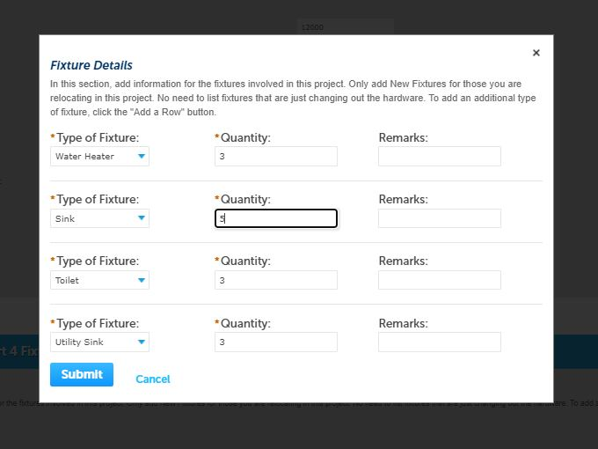
Complete your plumbing fixtures using ADD A ROW. You can select numerous rows and add all your fixtures with the drop downs in one field. Select SUBMIT, then CONTINUE APPLICATION.
Required documents listed must be uploaded using the ADD or SELECT FROM ACCOUNT buttons. Note the file types that are acceptable. Large PDF files may need to be flattened in order to meet the 100 MB maximum allowed

Slide 11
Using the TYPE drop down, choose the correct title for each document downloaded. If all required documents are not added, the application will not advance. Select the blue SAVE button once your documents are loaded. Next, select SAVE AND RESUME LATER or CONTINUE APPLICATION.
At the summary page, you can EDIT any field as necessary. Once complete, read the required certification information and check the box. Select CONTINUE APPLICATION.

Slide 12
Pay your fees in order to submit your application. You will be given the opportunity to pay or defer for another time. You will be directed to a third-party site for payment when you decide to pay. Once payment is complete, your application is given a record number used for the duration of your project at DuPage County. Congratulations!

